Slide 1
Lord of the Flies

Slide 2
Background Information

Slide 3
William Golding, recipient of the Nobel Prize for Literature in 1983, is a British author whose works, including Lord of the Flies, examine the conflict between good and evil that exists within all human beings. Before achieving success as a writer, he worked as a teacher, and he also fought with the British Royal Navy in World War II.
How do you think Golding’s life experiences shaped his views on the existence of good and evil within all people?

Slide 4
“It [Lord of the Flies] was simply what seemed sensible for me to write after the war when everyone was thanking God they weren’t Nazis. I’d seen enough to realize that every single one of us could be Nazis.” – William Golding
What does this quote mean to you?

Slide 5
Reading Guide
Chapters | Themes | Characters | Imagery | Symbols | Questions
1-2
3
4-6
7-9
10
11-12

Slide 6
Reading Deadlines:
Tuesday, March 8: Reading Day
Wednesday, March 9: Chapters 1-2
Thursday, March 10: Chapter 3
Friday, March 11: Partial Reading Day
Monday, March 14: Chapters 4-6
Wednesday, March 16: Chapters 7-9
Thursday, March 17: Chapter 10
Friday, March 18: Partial Reading Day
Monday, March 21: Chapters 11-12

Slide 7
Chapters 1-2

Slide 8
Synectics
Label a new page in your notes “synectics.”
As we read Lord of the Flies, I will be asking you to make connections between the novel and specific images.
Expectations:
Number each response.
Write at least a paragraph.
Be as specific and creative as possible.

Slide 9
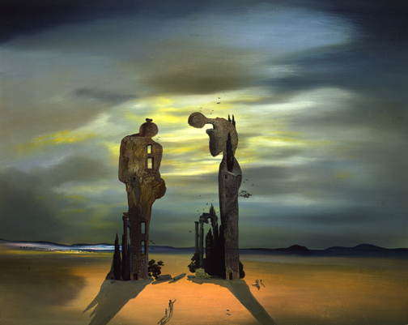
Synectic 1
“Archeological Reminiscence of Millet’s ‘Angelus’”
Salvador Dali

Slide 10
Evaluate
List the main rules of the society that the boys create.
Summarize the group’s priorities.
In a paragraph, evaluate these rules and priorities. Consider the following:
Are they good rules and priorities?
Will these rules and priorities help the group survive?
How could the rules and priorities be improved?

Slide 11
Chapter 3

Slide 12
Synectic 2
“Blue Segment”
Wassily Kandinsky

Slide 13
Jack
Ralph
Reread the first three paragraphs of chapter 3 (pages 48-49).
Make some notes about the following:
How has Jack changed? Consider ALL aspects of his change.
What are Jack’s priorities? Consider what he feels compelled to do.
Review pages 50-53.
Make some notes about the following:
What is Ralph focused on?
What are his priorities?

Slide 14
Chapters 4-6

Slide 15
Synectic 3
“Robe”
Jeanette Cole

Slide 16
Chapters 4-6
Write a full paragraph that includes at least two specific, cited details from the book about one of the following topics:
Golding’s description of the island
The theme of ch. 4-6 (remember: what is Golding saying about good vs. evil OR what is Golding saying about civilization)
A major character in ch. 4-6 (Ralph, Piggy, Jack, or Simon)
When you finish, turn in your paragraph and work on chapters 7-9.

Slide 17
Chapters 7-9

Slide 18
Synectic 4
“Angel Planells”
Pablo Picasso

Slide 19
Chapter 10

Slide 20
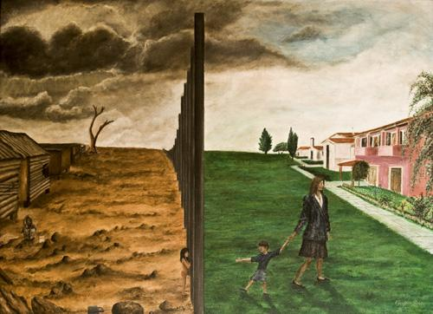
Synectic 5
“Loss of Innocence”
Gregory John

Slide 21
Discussion Questions
What are the key plot developments (5-6) that have happened in chapters 4-10? Consider WHY they are important when making your decision.
Decide why the following are significant in light of what Golding is trying to do thematically in Lord of the Flies:
the masks the hunters wear
the parachutist
the Beast
Piggy’s glasses
the conch shell

Slide 22
Chapters 11-12

Slide 23
Synectic 6
“Promised Counting”
Don Wesley

Slide 24
Literary Analysis Essay Outline
Introduction
Give title and author of the novel
Briefly summarize the plot of Lord of the Flies
Thesis: State the theme and the literary elements you will discuss to prove the theme.
Body Paragraph 1
Topic Sentence/Main Idea: State one literary element you will use to discuss the theme
Evidence: Quote or paraphrase from the book (cite page numbers!)
Analyze: Explain how the quote/paraphrase shows the literary element and theme
Evidence: Quote or paraphrase from the book (cite page numbers!)
Analyze: Explain how the quote/paraphrase shows the literary element and theme
Evidence: Quote or paraphrase from the book (cite page numbers!)
Analyze: Explain how the quote/paraphrase shows the literary element and theme
Body Paragraph 2 (same format as BP1)
Body Paragraph 3 (same format as BP1)
Conclusion
Summarize your main points
Explain why the theme is important
Connect the theme to modern life/society

