Slide 1
Research Presentation
Examples

Slide 2
Sample Internal Citation
Many people died at very young ages because they did not know about germs and how germs caused disesase (O’Connoll 32).

Slide 3
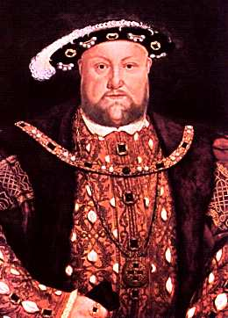
Sample Image Citation
(Horenbout)

Slide 4
Sample Works Cited
Horenbout, Lucan. Henry VIII. Art Gallery of South Australia. Shakespeare Internet Editions. Web. 2 February 2015.
“Life in Shakespeare’s Time.” BBC. 2014. Web. 2 February 2015.
O’Connoll, Fran. Elizabethan England. New York: Holt, 1994. Print.

